Slide 1
CIS5528 Predictive Modeling in Biomedicine
Lecture 2
Xinghua Mindy Shi 01/24/2022

Slide 2
Timeline
Project 1-paged white paper due Tuesday Jan 31 (not graded, will meet per team based on the 1-pager)
Project Proposal Presentation and Report (10 points in total, 5 for presentation, 5 for report)
Background, significance and literature review (1.5)
Novelty and contribution (1)
Methods (2)
Expected Results (1.5)
Feb 14, Tuesday, Project Proposal Presentations
Each team has 13 minutes (10-minute presentation + 3-minute Q&A)
Feb 21, Tuesday, 5pm EST, Project Report Due
Each team submits a written report (4-5 pages, single spaced, formatted like a project proposal or research article, with Text, Figures and Tables all come from your own work, use proper citations and references)
2

Slide 3
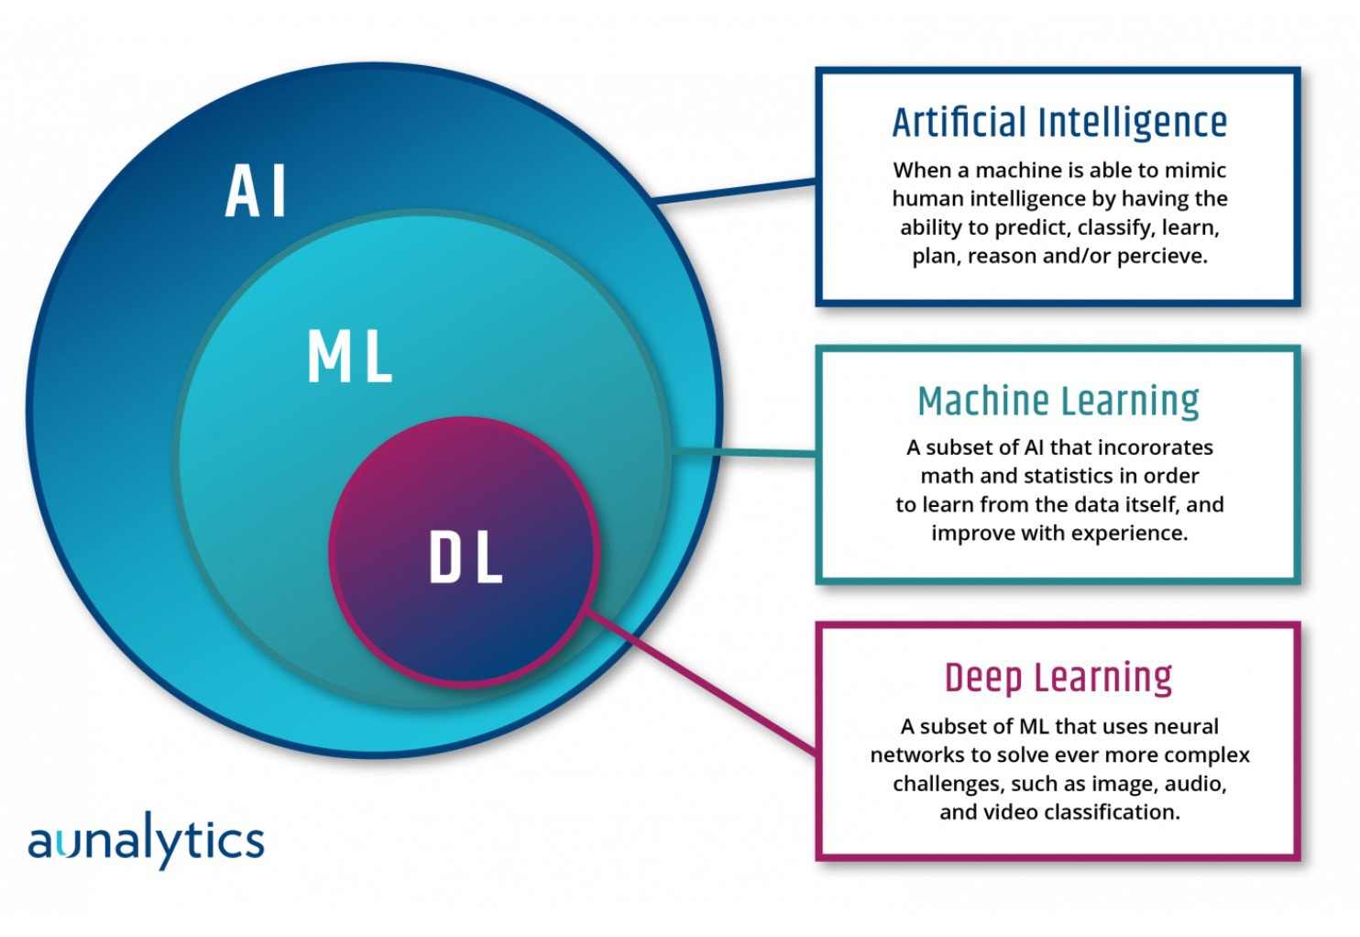
AI, ML, DL
Historically, both Alan Turing’s “Thinking Machines” and John McCarthy’s “machines that could think autonomously” were the definitions used for AI.
As AI Systems evolved, we are now referring to AI as
“machines that respond to stimulation consistent with
traditional responses from humans, given the human capacity for contemplation, judgment, and intention.”
https://www.aunalytics.com/artificial-intelligence-machine-learning-and-deep- learning%E2%81%A0/
https://towardsdatascience.com/ai-machine-learning-deep-learning-explained- simply-7b553da5b960
3

Slide 4
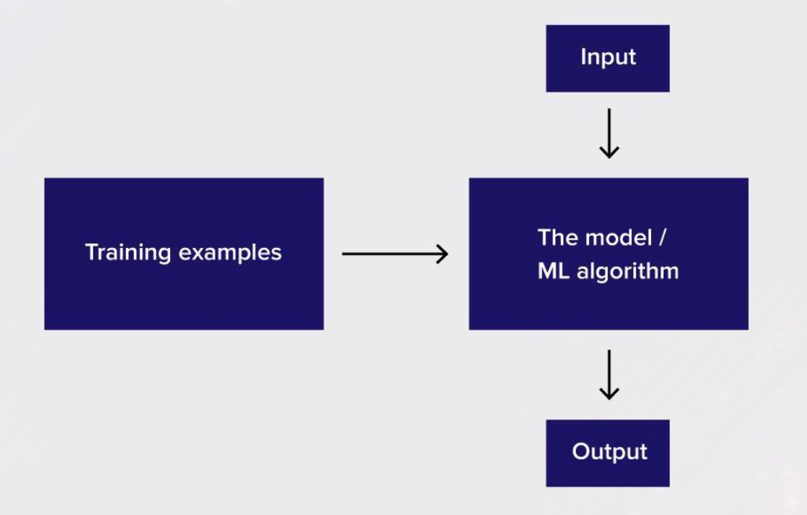



Machine Learning
ML = Data + Algorithms
Training
Input
Output
https://towardsdatascience.com/ai-machine-learning-deep-learning-explained- simply-7b553da5b960
4

Slide 5
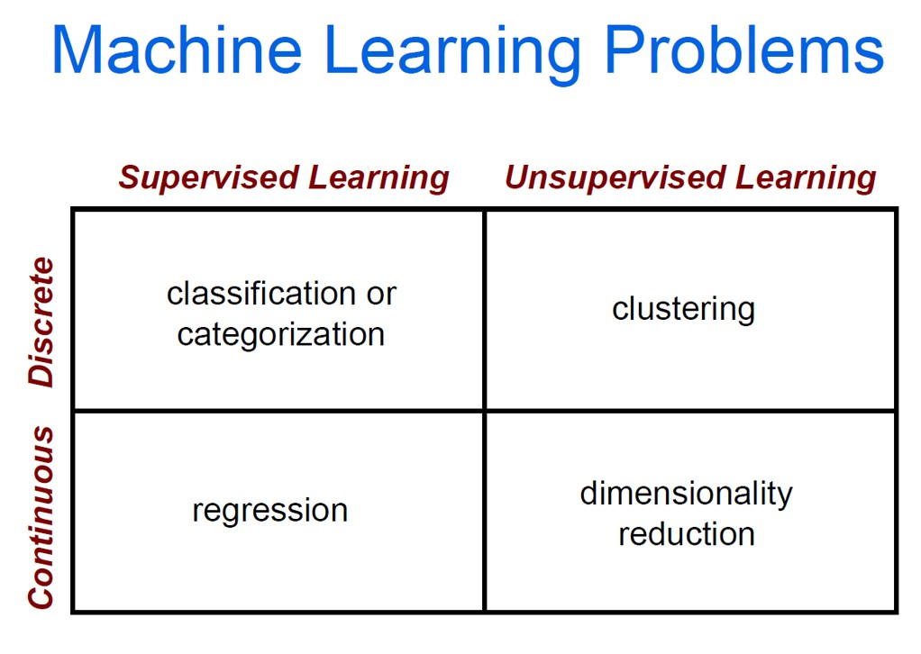
5

Slide 6
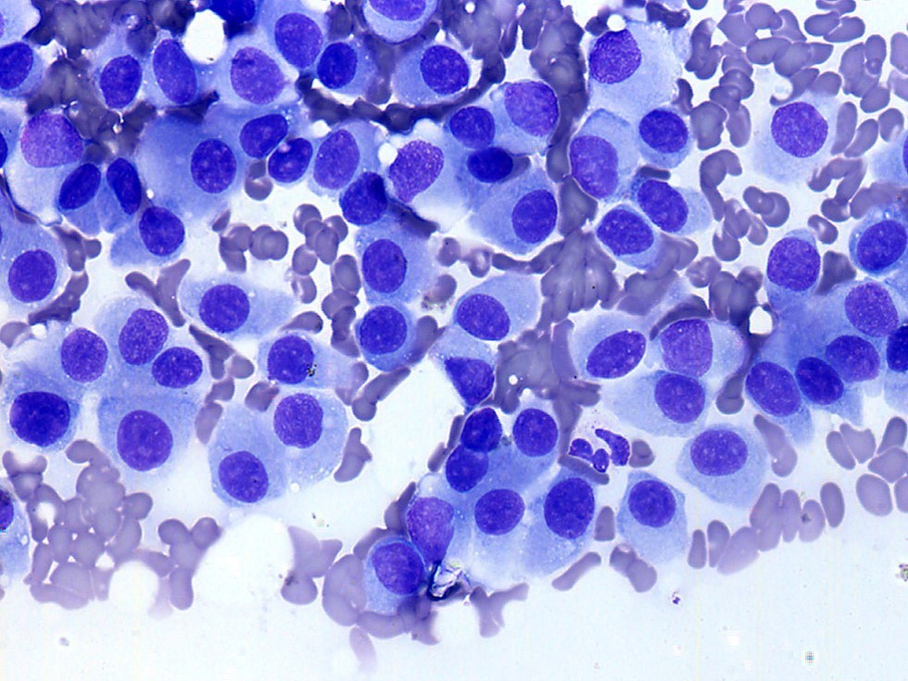
ML Algorithms
Supervised learning – Training data is labelled
 | Semi Tra | -supervised learning ining data is partially labelled
Unsupervised learning – Training data is unlabeled Reinforcement learning
https://www.guru99.com/supervised-vs-unsupervised-learning.html
6

Slide 7
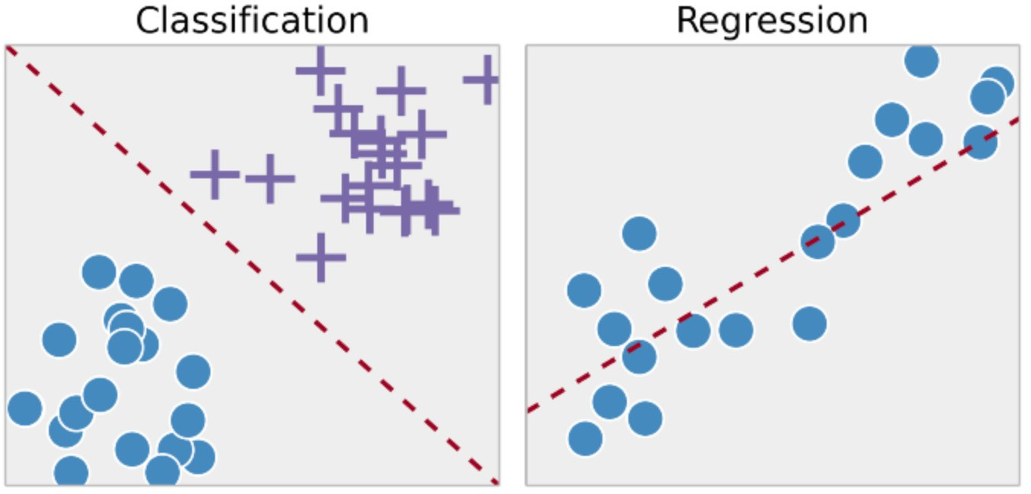
Supervised Learning
Training data is labeled: (X,Y) https://www.guru99.com/supervised-vs-unsupervised-learning.html

Slide 8
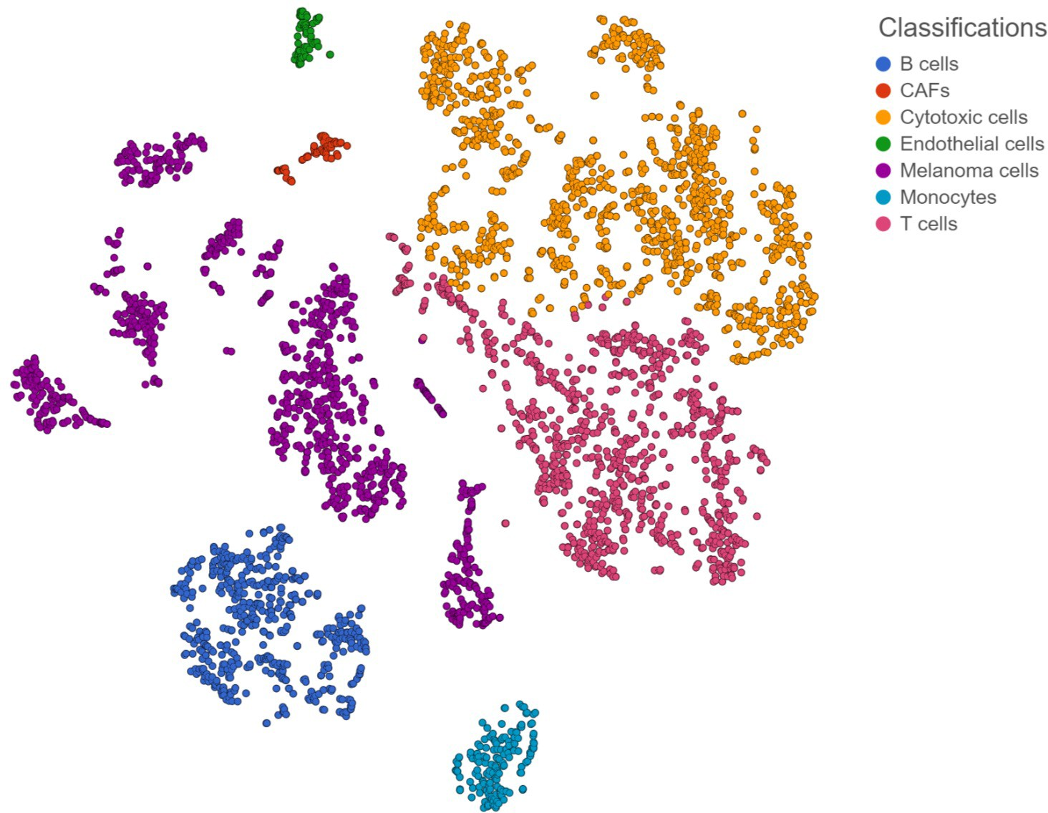
Unsupervised Learning
Training data is unlabeled: X https://www.partek.com/application-page/single-cell-gene-expression/

Slide 9
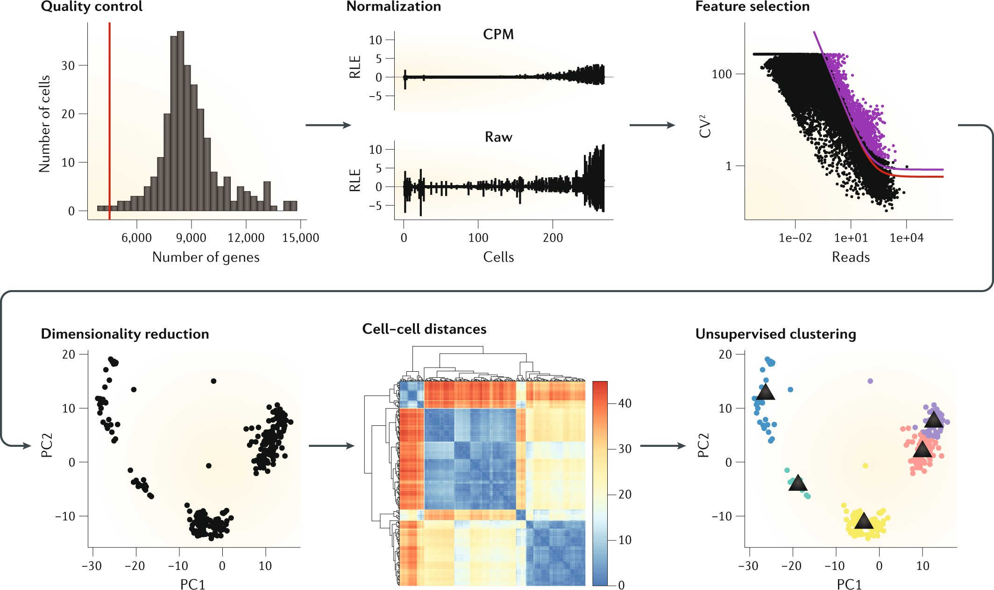
Unsupervised Learning
Kiselev, Vladimir Yu, Tallulah S. Andrews, and Martin Hemberg. "Challenges in unsupervised clustering of single-cell RNA-seq data." Nature Reviews Genetics 20.5 (2019): 273-282.
9

Slide 10

Reinforcement learning

Slide 11
Project Ideas
Read classical and new papers on a specific topic
Reproduce or develop new strategies for analyzing published data
Aggregate/Integrate data from multiple resources and apply new analytics
Open challenges for bioinformatics and data mining
– CASP, CAGI, CAMI, DREAM, iDASH
KDD Cup
UCI Machine Learning Repository

Slide 12
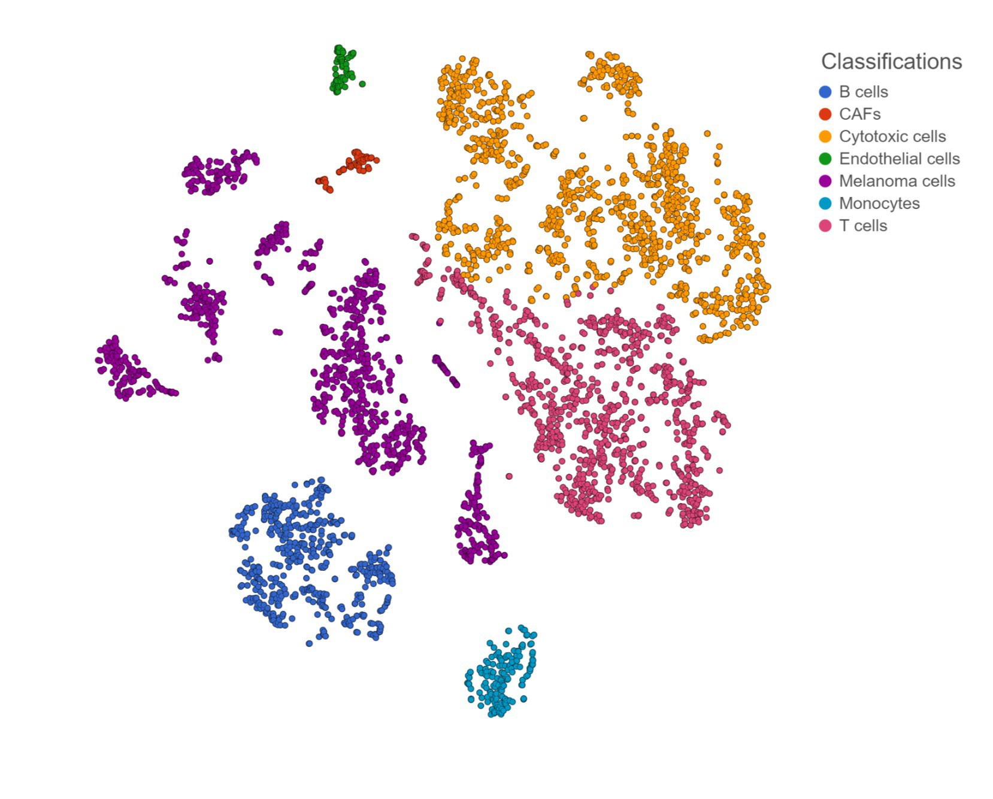
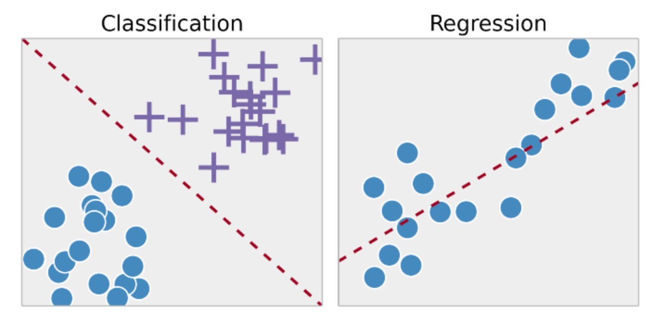
Prediction Tasks
Tabular data (mostly, can include imaging data) -> clustering/classification/regression

Slide 13

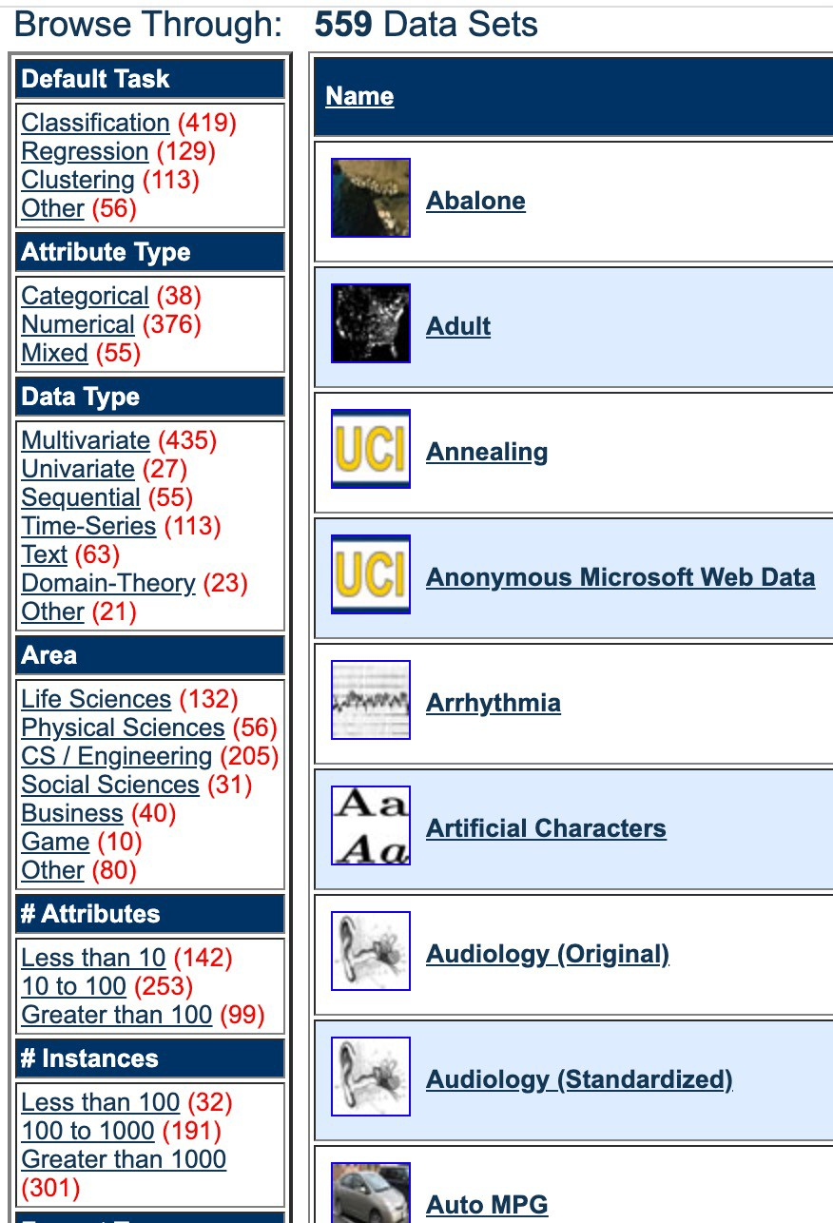

Slide 14
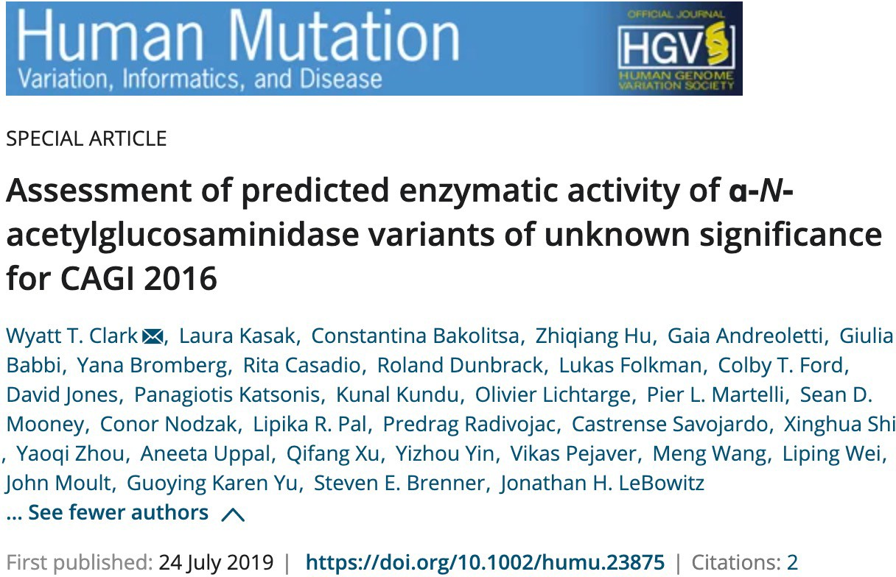
CAGI 2016
Predict the impact of unknown disease significance (VUS) on the enzymatic activity of the lysosomal hydrolase α-N-acetylglucosaminidase (NAGLU).
Deficiencies in NAGLU activity lead to a rare, monogenic, recessive lysosomal storage disorder, Sanfilippo syndrome type B (MPS type IIIB).

Slide 15
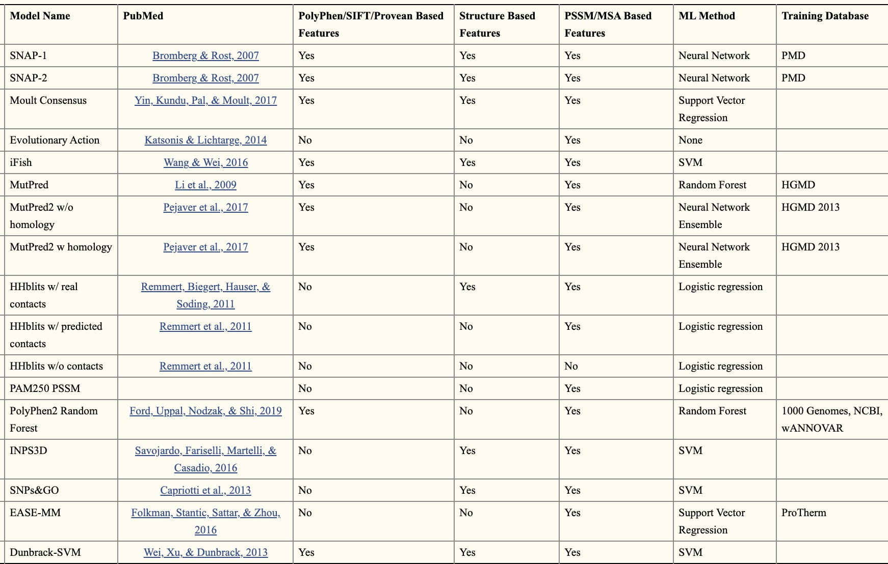
CAGI 2016

Slide 16
Prediction of Viral Susceptibility
DREAM 2016
Improving Presymptomatic prediction of viral susceptibility using DREAM Cohorts.
The GSE73072 Accession file provides full clinical and gene expression data on 104 subjects at five different time points.
41 subjects have been labelled as Symptomatic and Infected while the remaining 63 are Asymptomatic and Uninfected.
Gene Expression Data RMA normalized
Clinical Data and Viral Shedding outcomes |  | GSEA Analysis to identify enriched gene sets
SGLasso
HHSVM
Random Forest

Slide 17
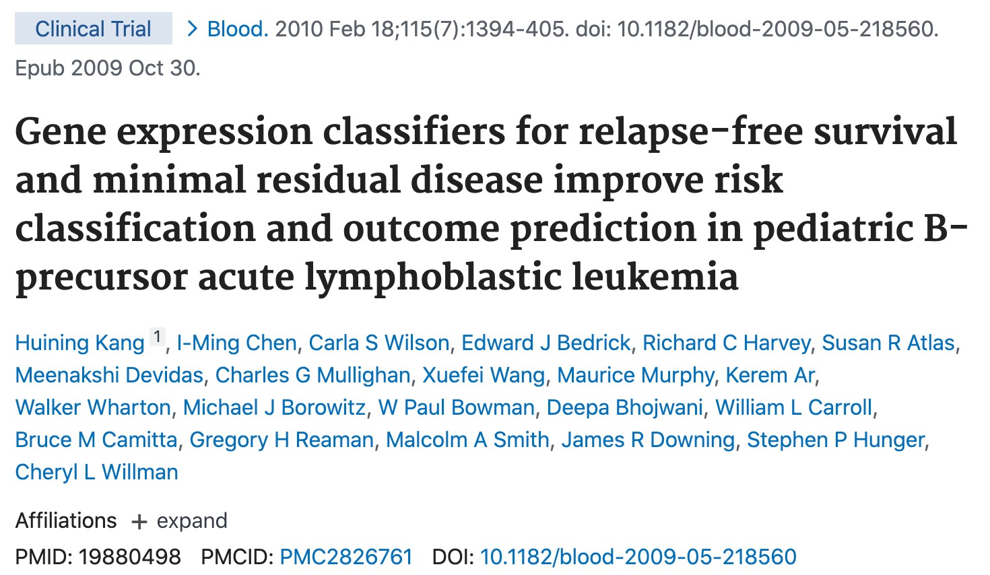
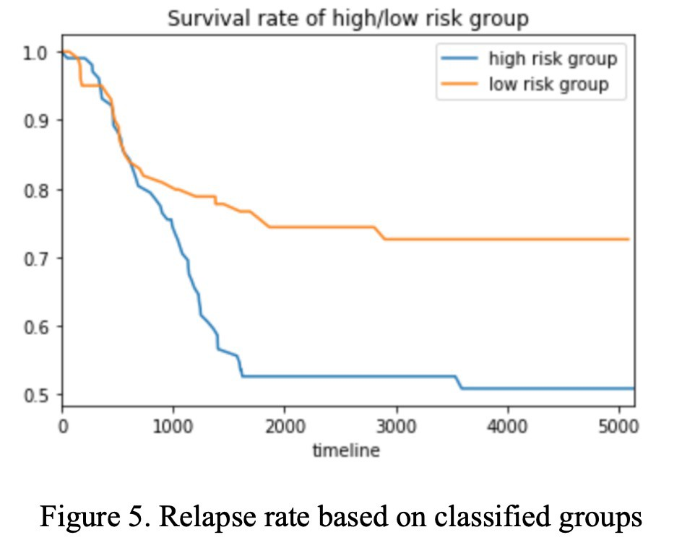
Prediction of High/Low Risk of Acute Lymphoblastic Leukemia
Using a published dataset, reproduce the analytics results using a different model.
Developed a COX-regression model based on the principal component analysis (PCA) of the gene expression’s COX-score.

Slide 18
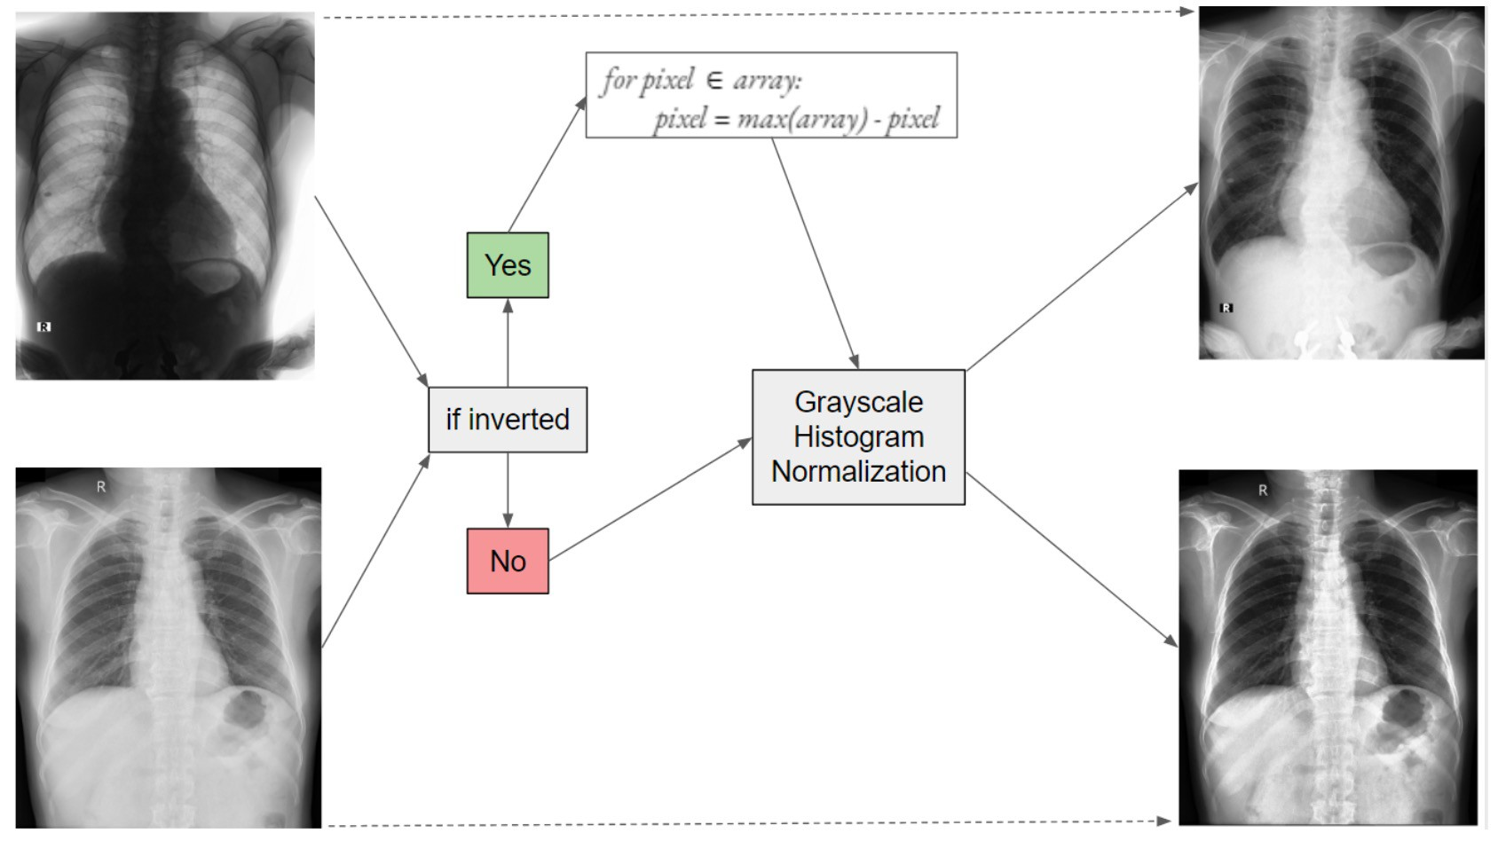
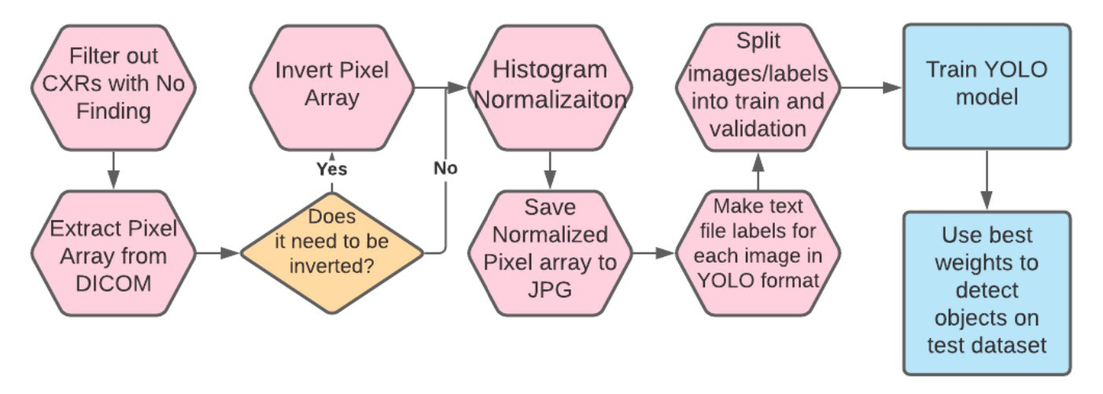
Classification and Localization of Chest X-Ray Abnormalities

Slide 19
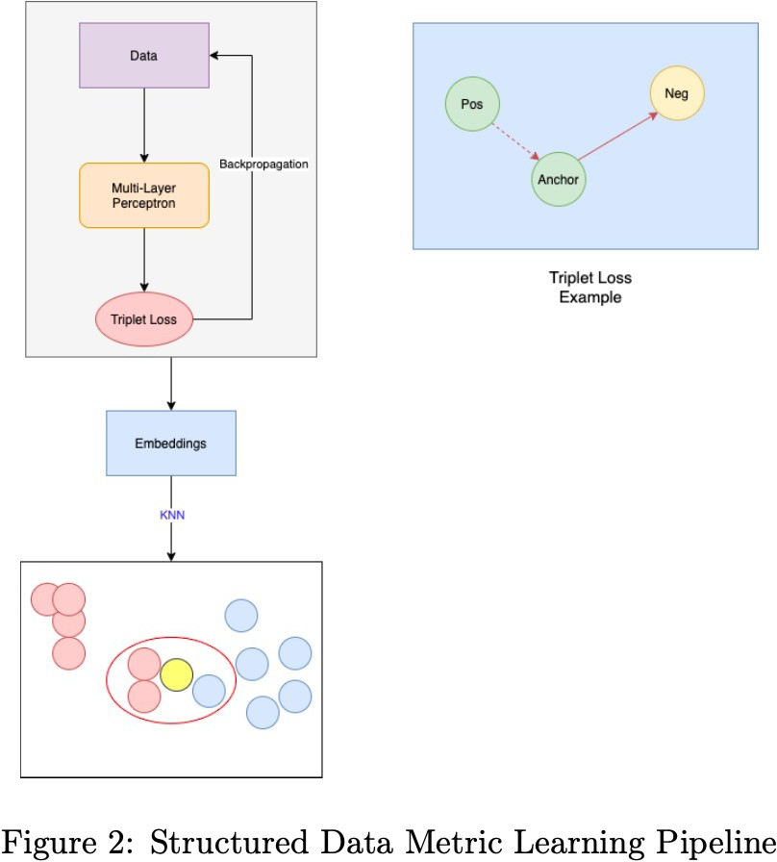
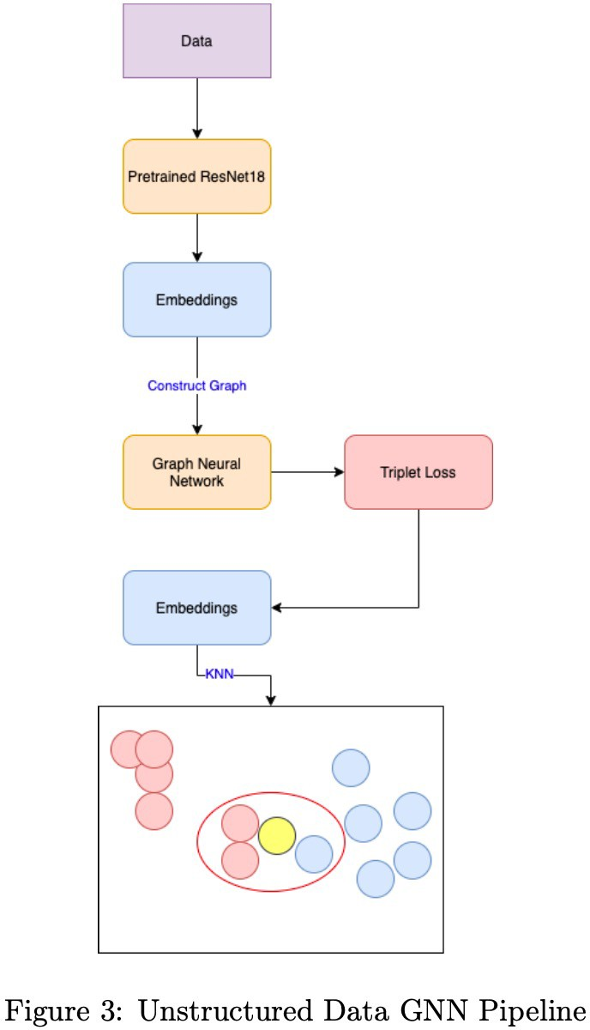
Machine Learning in Medicine Reports

Slide 20
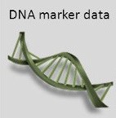
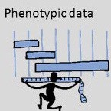
Phenotype Prediction
B
(Associations)
X
(Genotypes)
…
Y
(Phenotype)
b₁ b₂ b₃
v₁v₂v₃
v_{p}
s₁ s₂ s₃
y₁ y₂ y₃
+ E ≈ (Noise)
…
…
…
s_{n}
y_{n}
y = µ + XB + ε
b_{p}

Slide 21
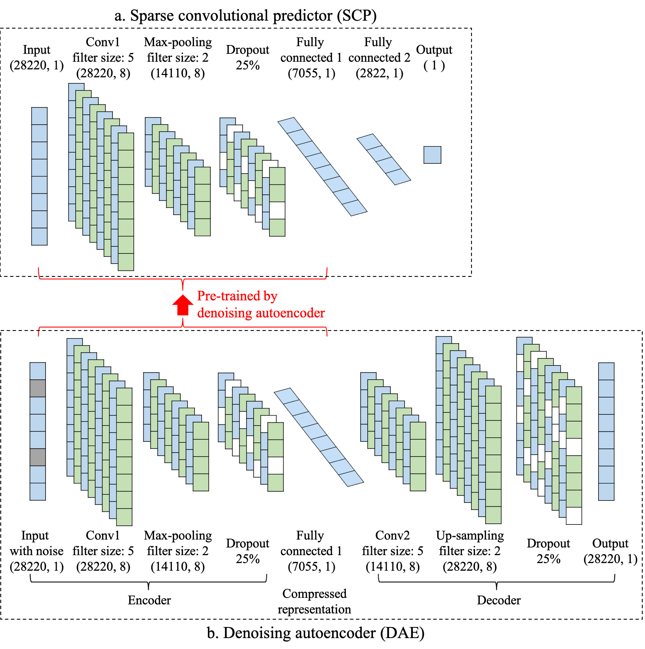
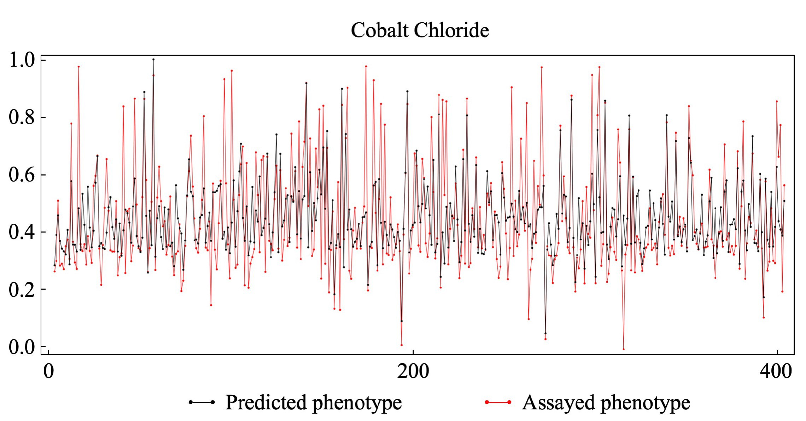
Bloom JS et al. 2015; Forsberg FS et al. 2017
https://github.com/shilab/SCP_DAE
Chen J and Shi X, ACM BCB 2019

Slide 22
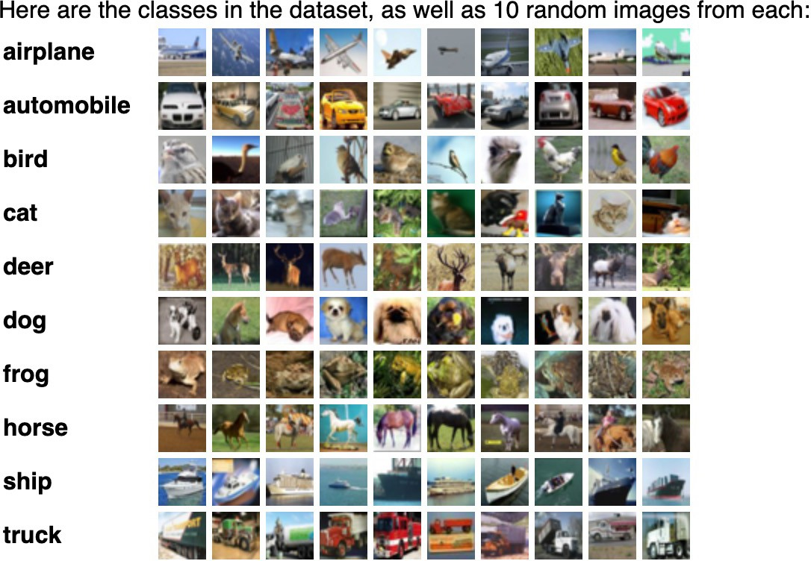
Imaging
The CIFAR-10 dataset consists of 60000 32x32 colour images in 10 classes, with 6000 images per class. There are 50000 training images and 10000 test images.
https://www.cs.toronto.edu/~kriz/cifar.html

Slide 23
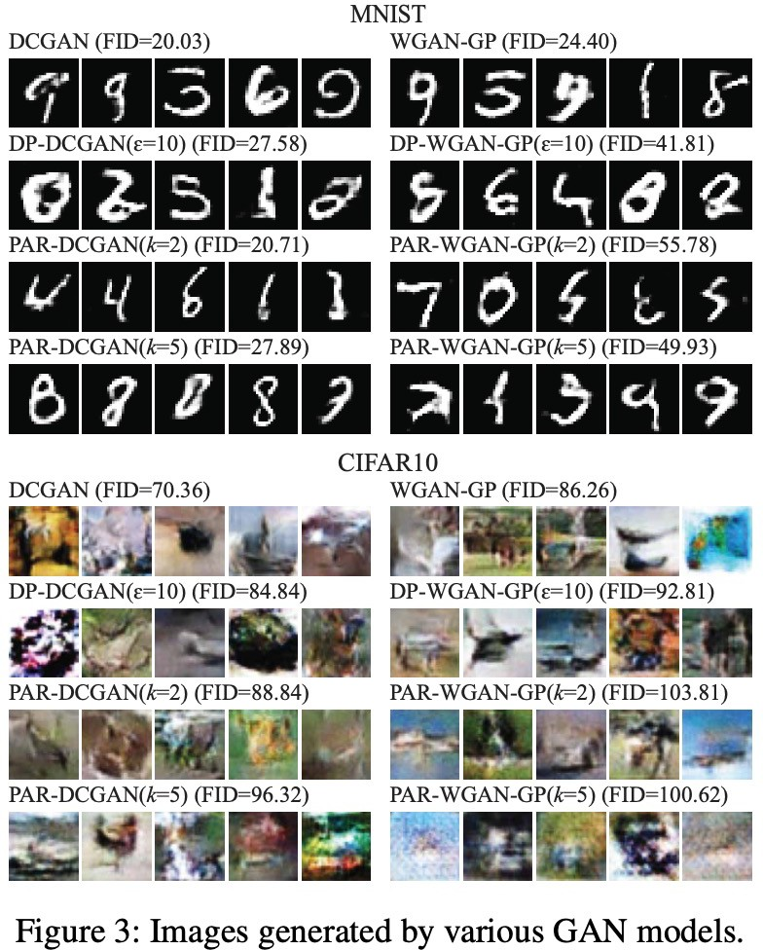

Slide 24
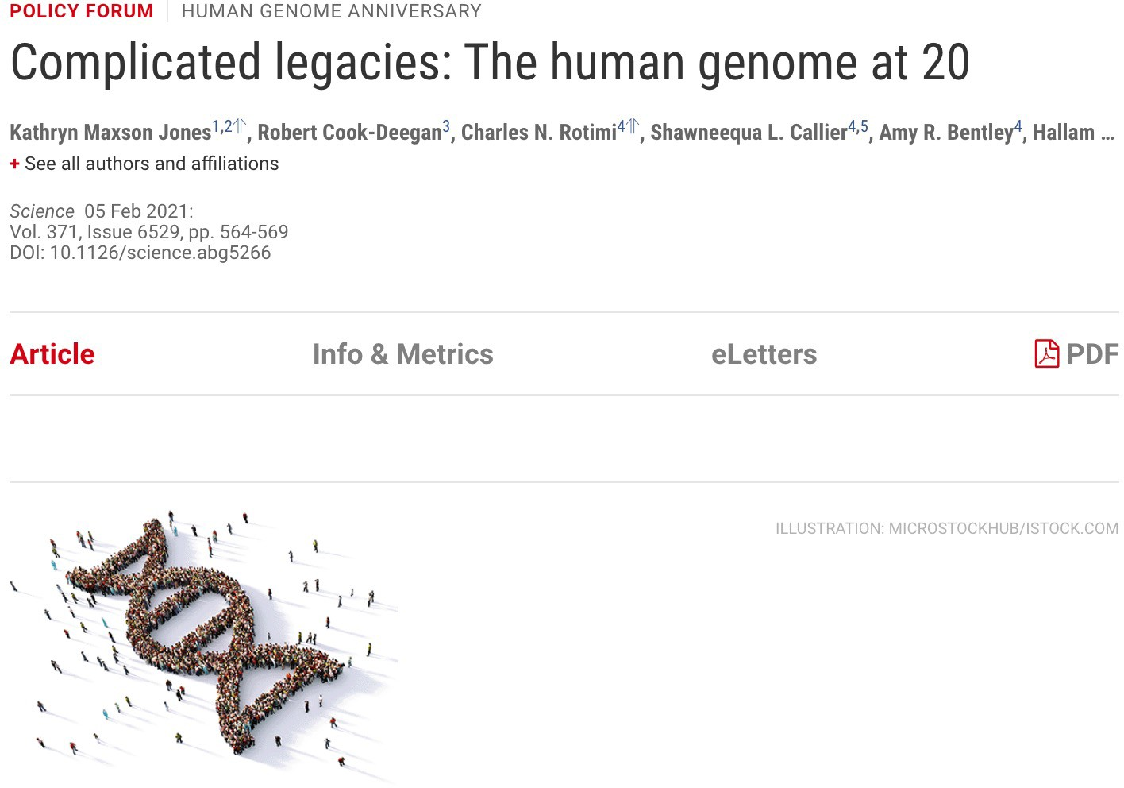
An ethos of rapid data sharing, more relevant than ever.
Lack of diversity hinders the promise of genome science.
Algorithmic biology unleashed.
Value and affordability in precision medicine.
End the entanglement of race and genetics.
Genetic privacy in the post-COVID world.
Emerging ethics in Indigenous genomics.
Polygenic risk in a diverse world.
Risks of genomic surveillance and how to stop it.
https://science.sciencemag.org/content/371/6529/564
24

Slide 25
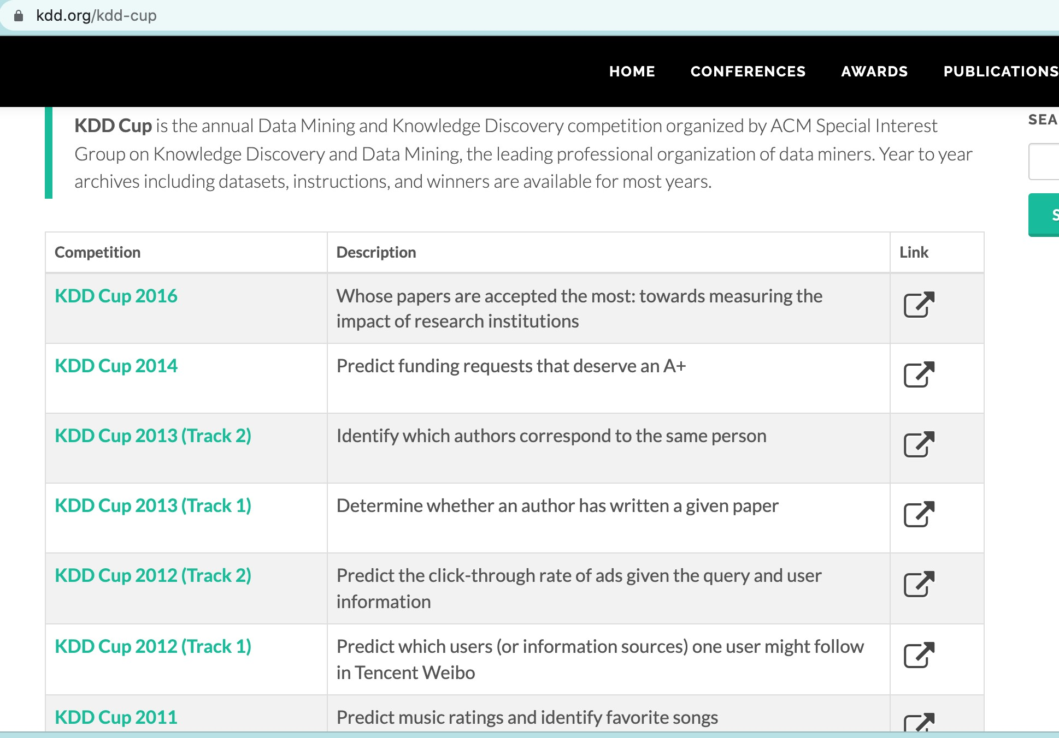
KDD Cup

Slide 26

Kaggle

Slide 27
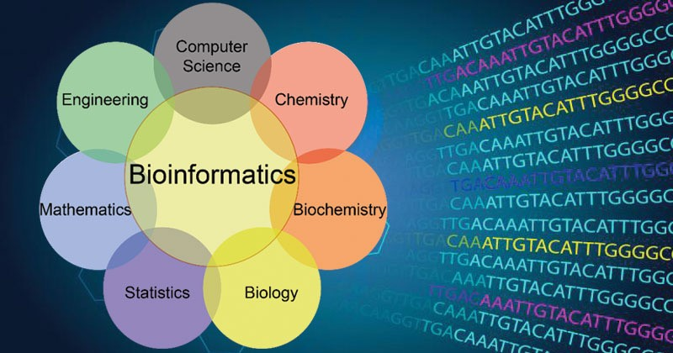


Bioinformatics
https://microbenotes.com/bioinformatics-introduction-and-applications/

Slide 28

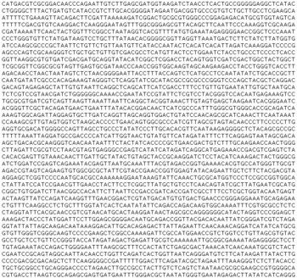
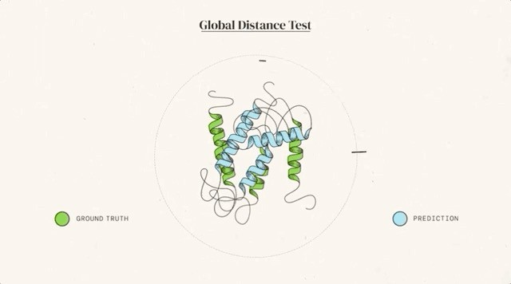
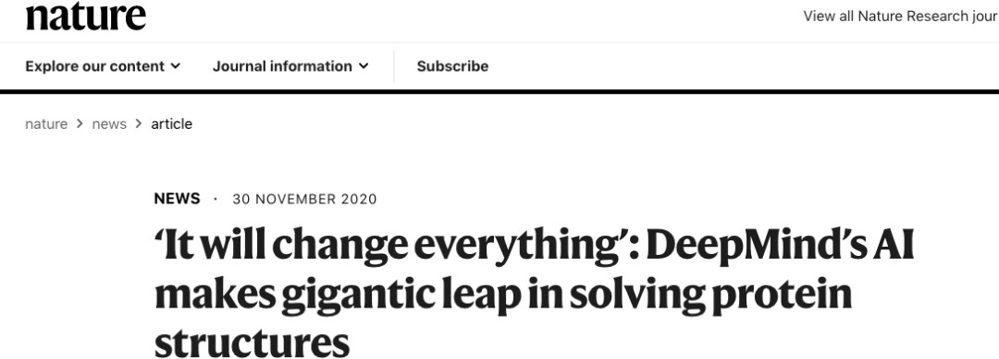
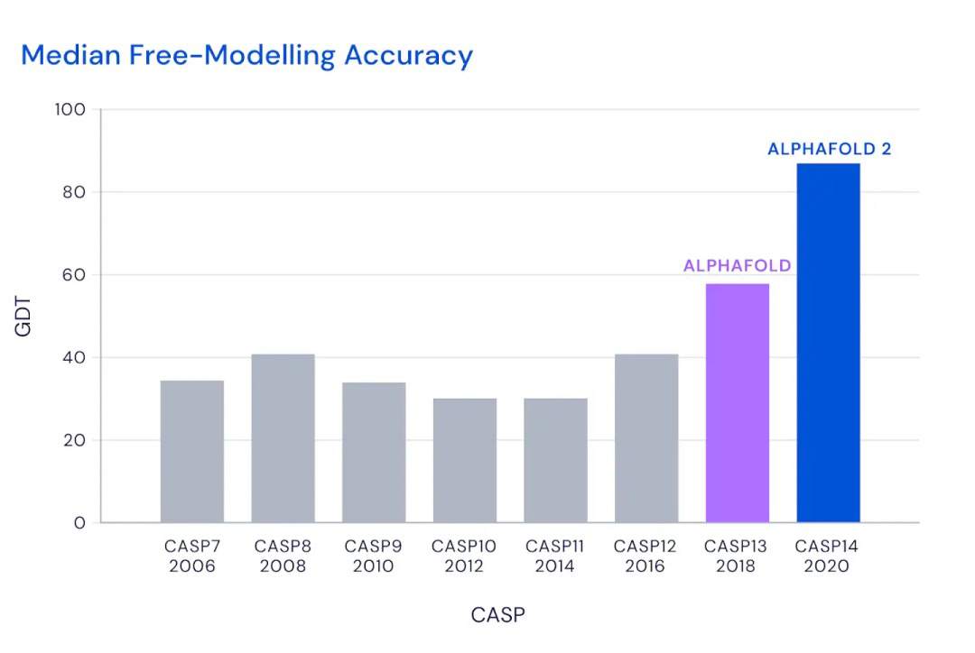
Can we predict how proteins will fold?
How do proteins find their partners?
Is an Effective HIV Vaccine Feasible?
Can We Selectively Shut Off Immune Responses?
Why Do Humans Have So Few Genes?
To What Extent Are Genetic Variation and Personal Health Linked?
What is all that “junk” doing in our genomes?
How can genome changes other than mutations be inherited?
What roles do different forms of RNA play in genome function?
What Determines Species Diversity?
What Genetic Changes Made Us Uniquely Human?
How Can a Skin Cell Become a Nerve Cell?
How Does a Single Somatic Cell Become a Whole Plant?
How Will Big Pictures Emerge From a Sea of Biological Data?
What Controls Organ Regeneration?
What Are the Limits of Conventional Computing?
28

Slide 29
Outline
Topic I: Sequence Analysis
Part I: Introduction to genetic variation and sequence analysis
Part II: Applications of optimization and machine learning to sequence analysis
29

Slide 30
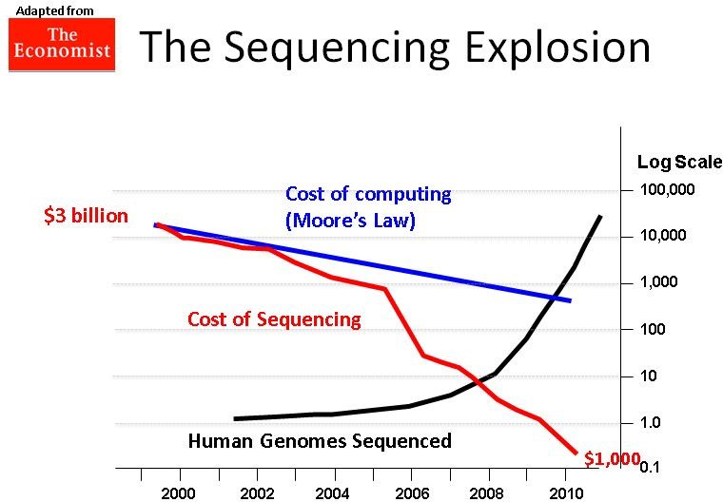


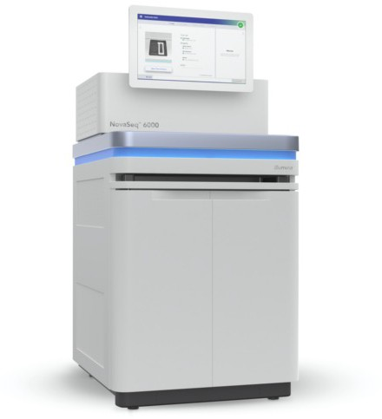
Processing this 3-billion-base-pair human genome takes immense computing power
1988
NIH &DOE
Human
Genome Project
2017
Illumina NovaSeq:
$100 per human genome 1 hour
30
Sanger sequencing:
$3 billion per human genome
~5 years

Slide 31
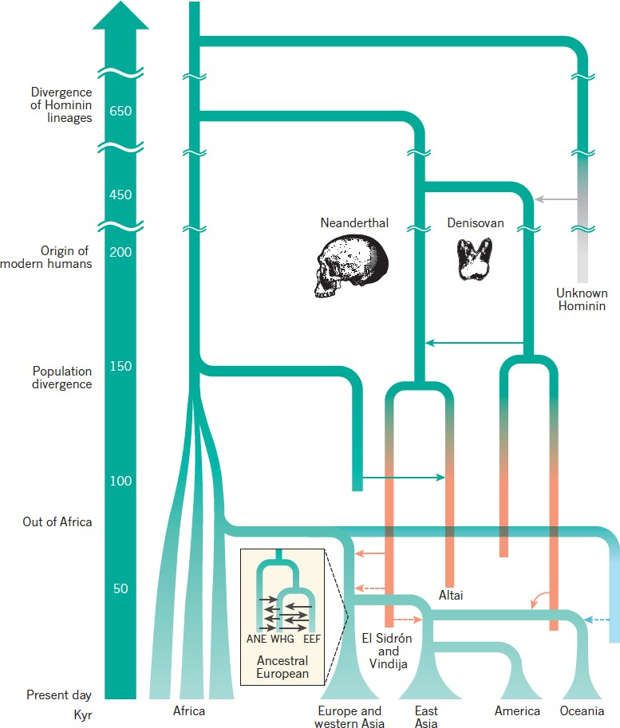
Simplified Model of Human Evolutionary History
Relationships btw contemporary populations and the approximate times at which they diverged are shown, including admixture events between groups of modern humans and between modern and archaic humans (well established in solid lines and tentative in dashed lines ).
Nielsen et al. Nature. 2017

Slide 32
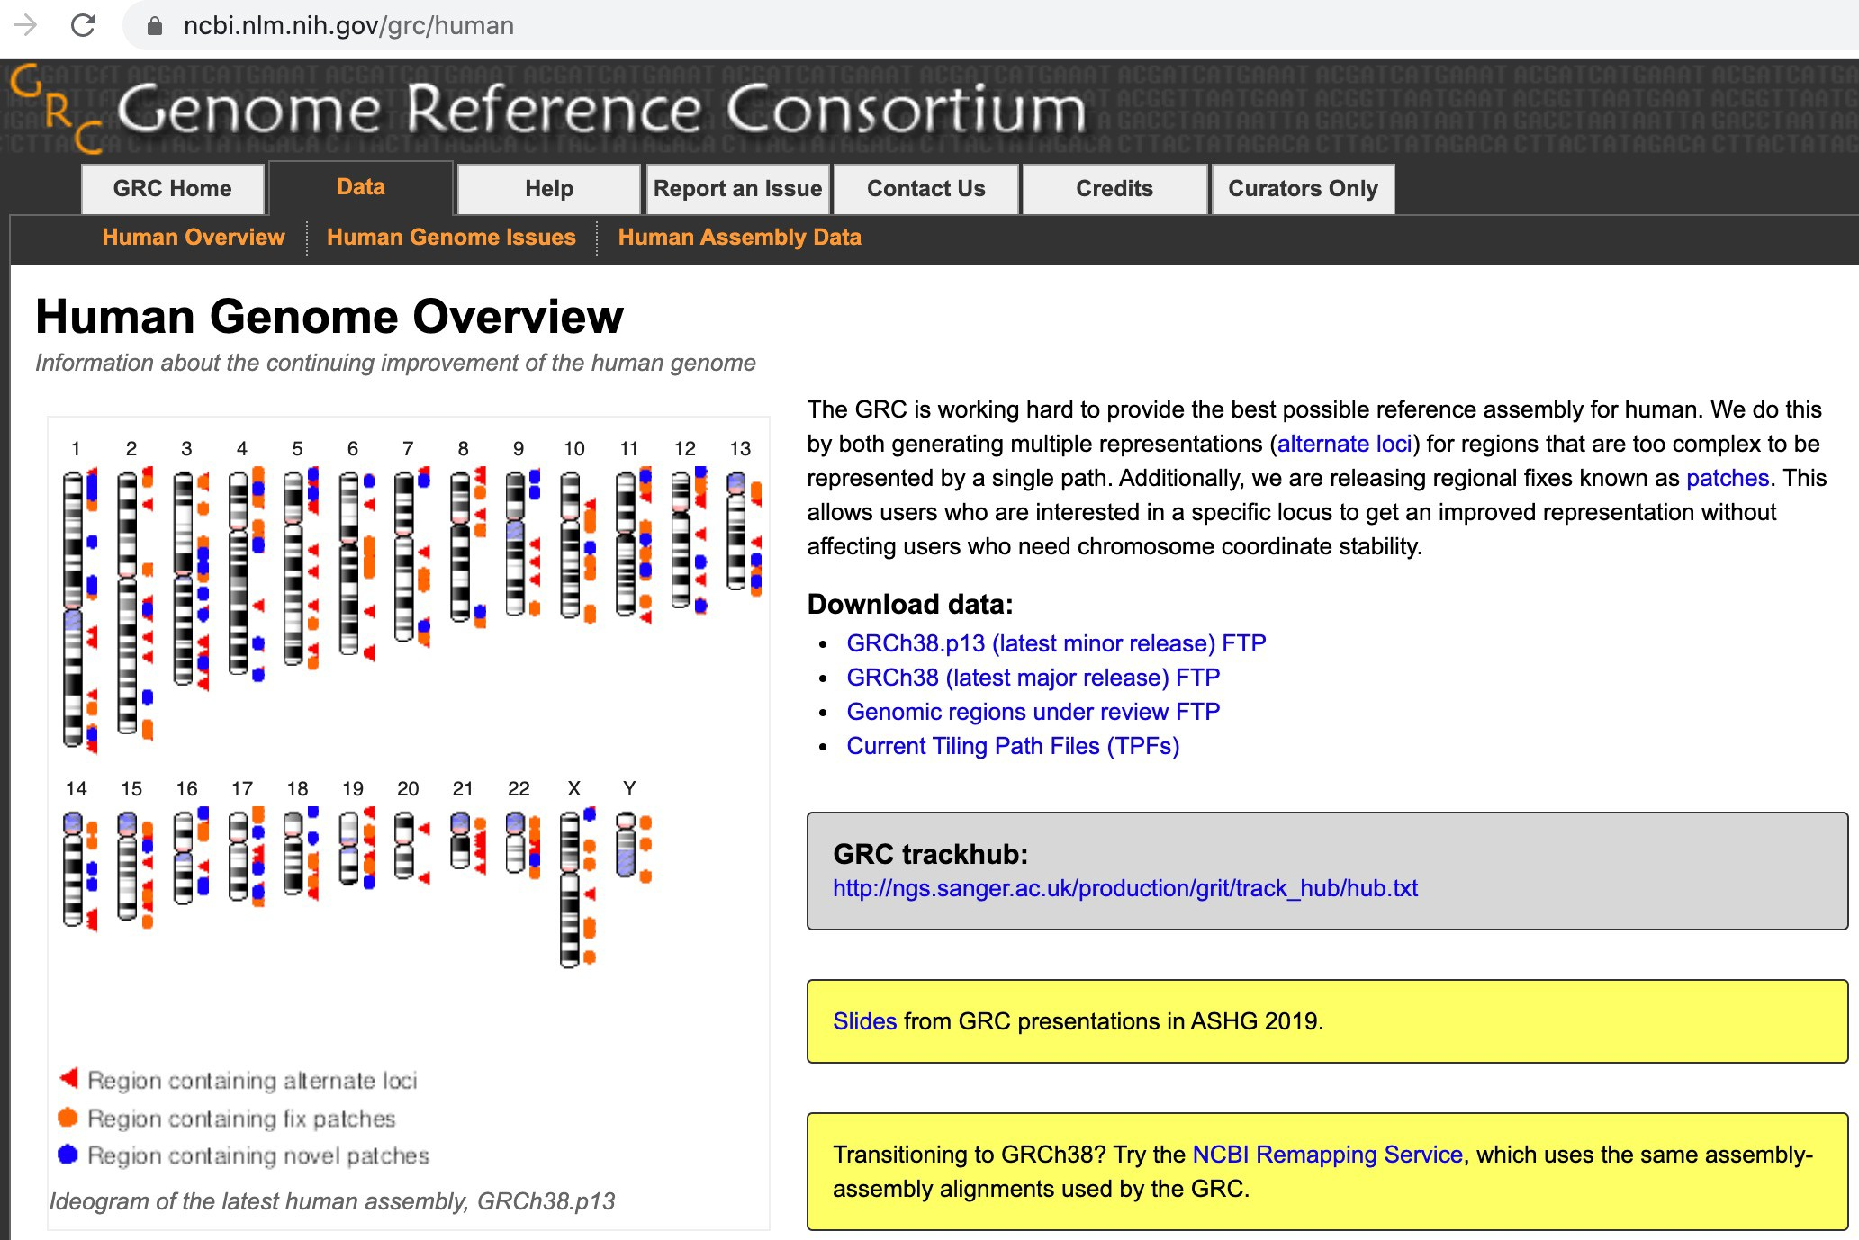
32

Slide 33


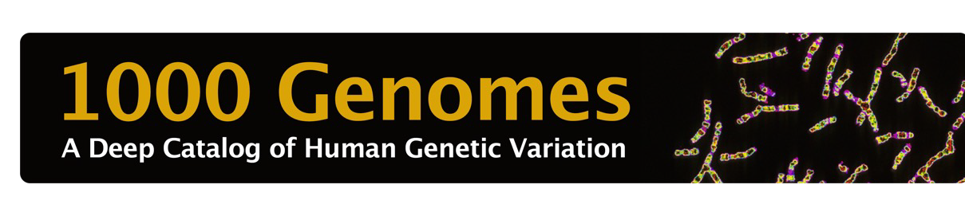

Human Genetic Variation
Single Nucleotide Variants (SNVs)
o 1bp
A
Ref.
Sample
C
o Over eighty millions, ~0.3% genetic difference
Small Insertions and Deletions (INDELs)
Multiple base pairs (1bp ~ 50bp, arbitrary)
Tens of millions, ~0.3% genetic difference
A
Ref.
Sample
T C A
33

Slide 34




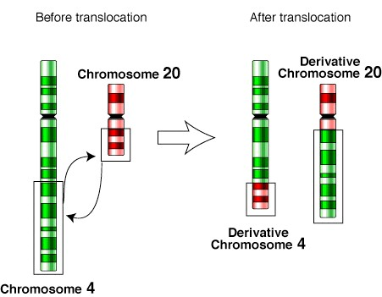

Human Genetic Variation
Structural Variants (SVs)
A large number of base pairs (50bp+, arbitrary)
Abundant in healthy human populations
Iafrate, AJ, et al. Nature Genetics, 2004.
Sebat, J., et al. Science, 2004.
~100 thousands, ~0.8% genetic difference
3-fold more likely with GWAS signals than SNVs
50-fold more likely to affect gene expression than SNVs
Encompasses:
Copy number variants (CNVs)
Deletions, Duplications, Insertions
Balanced events
Inversions, Translocations
Deletion
Ref.
Sample
Duplication
Ref.
Sample
Insertion
Ref.
Sample
)
Inversion
Ref.
Sample
33

Slide 35
SV Discovery from NGS
Deletions
Read Pair Mapping
BreakDancer, Delly, GenomeSTRiP, Pindel
CNVnator, GenomeSTRiP
Read Depth Analysis
frasegqmueenntcaitniogn
sample genome
deletion
expected
> expected
reference genome
exact breakpoints
sample genome
deletion
exact breakpoints
fsreaqgumeenncitnagtion
Delly, Pindel
Cortex
Split Read Alignment
Sequence Assembly
33

Slide 36
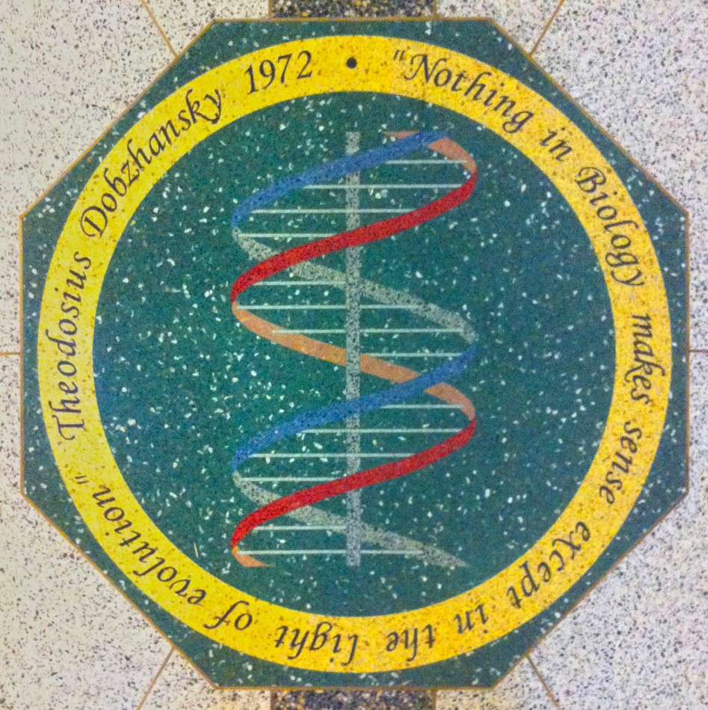
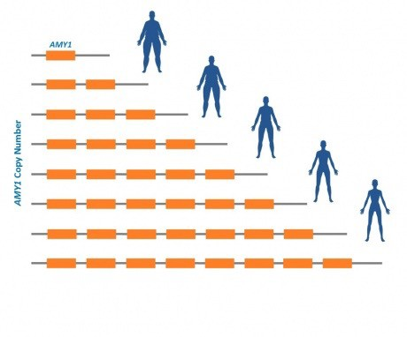

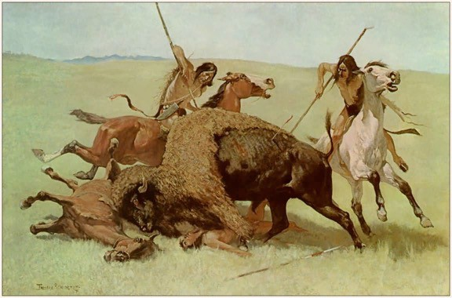
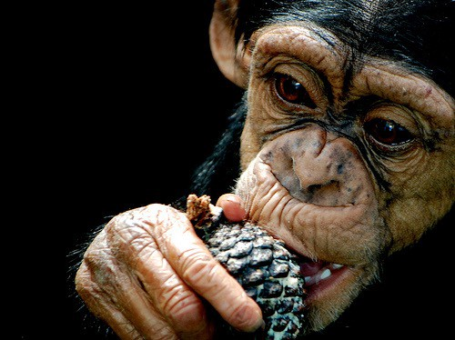
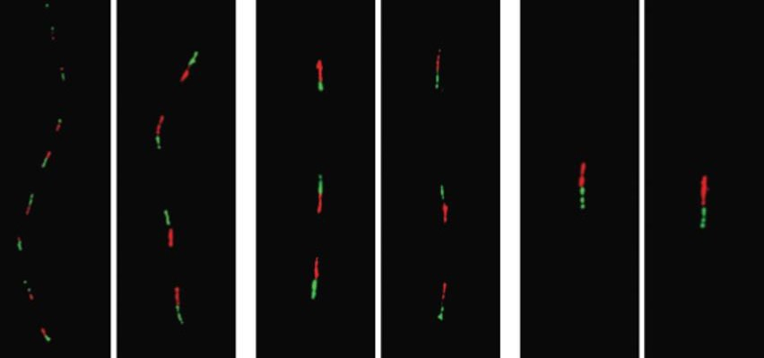
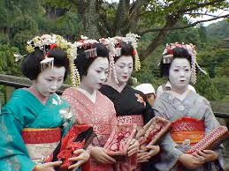
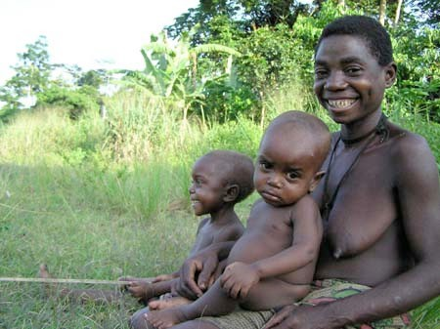
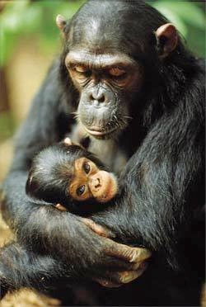
SVs and Evolution (and Diseases)
Salivary amylase gene Amy1: More copy numbers in populations with high-starch diets.
Mosaic medallion at Univ of Notre Dame
“Nothing in Biology Makes Sense Except in the Light of Evolution”
-
Theodosius
Dobzhansky
Japanese
Biaka (Africa)
Chimpanzee
Individuals with more copies of AMY1 were at lower risk of obesity.
14 copies
6 copies 2 copies
Perry GH et al. Nature Genetics 2007
Falchi M et al. Nature Genetics 2014 (Swedish) Mejia-Benitez, M. A. et al., Diabetologia, 2015 (Mexican)
33

Slide 37

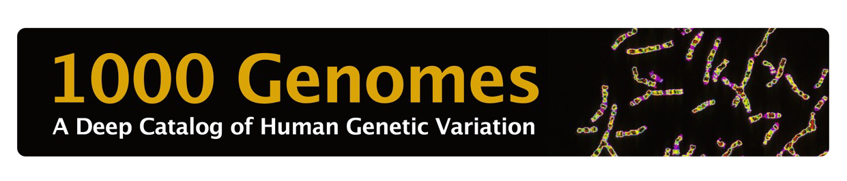
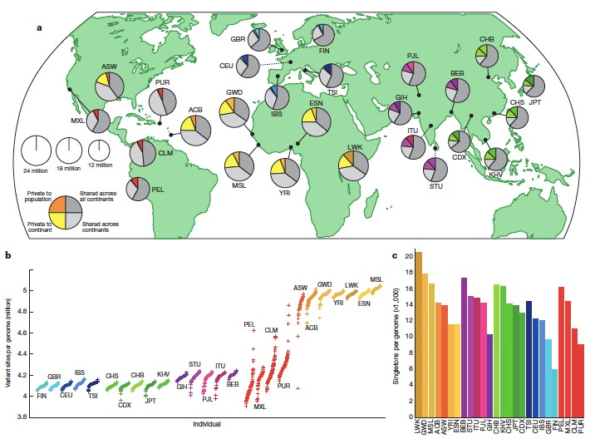
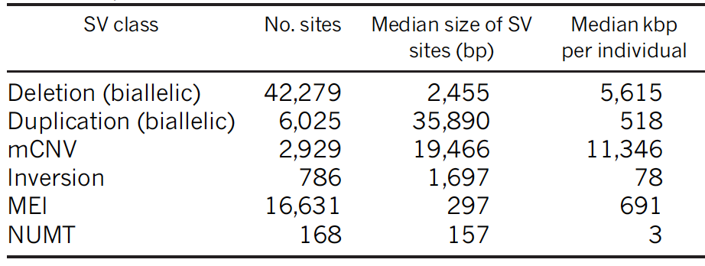
The 1000 Genomes Project
Andrew Quitadamo
Whole genome sequencing of 2504 individuals from 26 populations.
A typical genome differs from the
reference human genome at 4.1 ~5.0 million sites (2,100 ~2,500 SVs).
SVs are 3-fold more likely with GWAS signals than SNVs, and are 50-fold more likely to affect gene expression than SNVs.
Sudmant et al. Nature 2015; 1000 Genomes Project Consortium. Nature. 2015
33

Slide 38
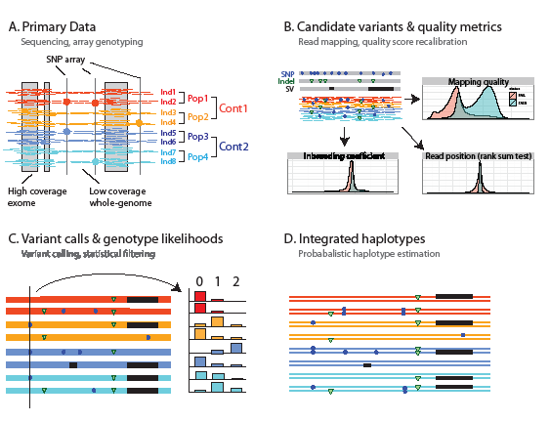
1000GP Workflow
1000 Genomes Project Consortium. Nature. 2012
33

Slide 39
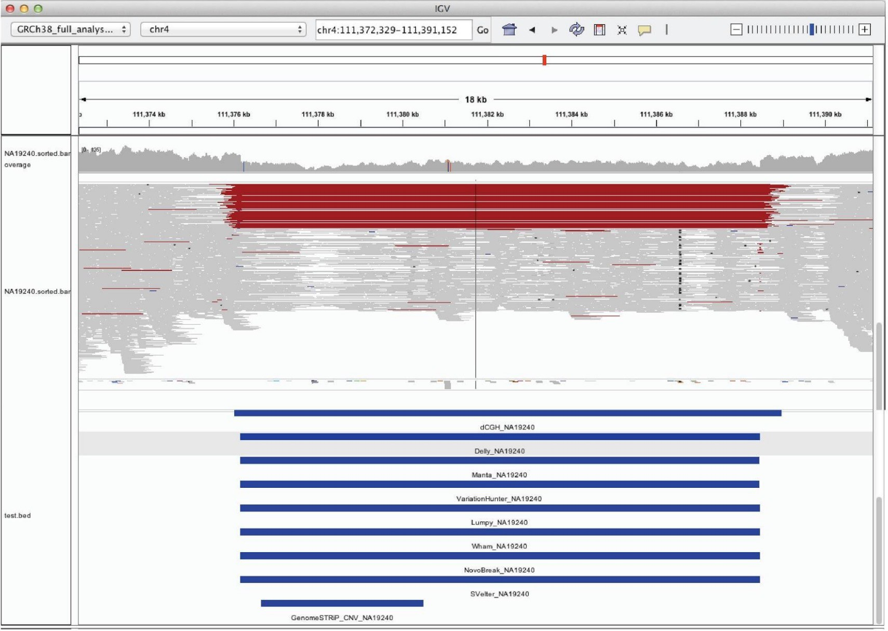
Alignment pattern of a 14Kb deletion that was uniquely discovered by Illumina algorithms.
39
Sudmant et al. Nature, 2015

Slide 40


Human Genome Structural Variation Consortium (HGSVC)
Identified 818,181 indel variants (<50 bp) and 31,599 structural variants (≥50 bp) per human genome, >7x increase in SVs compared to previous reports, including the 1000 Genomes Project.
40
Chaisson et al. Nature Communications, 2019

Slide 41




Human Genome Structural Variation Consortium (HGSVC)
Jia Wen
Conor Nodzak
The majority of het-SVs tested significantly affected the target gene expression in allele specific manner.
An example rules against the haploblock ASE effect
SNP-ASE
SV-ASE
41
Lappalainen T et al. Nature. 2013
Chaisson et al. Nature Communications, 2019

Slide 42

An Example of Phased Chromosomes
Characteristics of SNV-based haplotypes obtained from different data sources
42
Chaisson et al. Nature Communications, 2019

Slide 43



HGSVC2
Junjie Chen
Chong Li
De novo assembly of 64 haplotypes from 32 diverse human genomes, using long-read and strand-specific sequencing technologies
Catalog of 107,590 structural variants (SVs), of which 68% are not discovered by short-read sequencing
Graph-genotyping 50,340 SVs, with 1,525 expression quantitative trait loci (SV-eQTLs)
SV eQTLs are enriched for GWAS signals
GWAS and eQTL co-localization analysis using a Summary-data- based Mendelian Randomization (SMR) test identified 1,178 GWAS genes have an SV eQTL
43
Ebert et al. Science, in revision
https://www.biorxiv.org/content/10.1101/2020.12.16.423102v1

Slide 44

HGSVC2 Pipeline
Ebert et al. Science, in revision
https://www.biorxiv.org/content/10.1101/2020.12.16.423102v1
44

Slide 45




An Example of eQTL GWAS Associations
SV
Gene
A 1,069-base deletion (chr21-14088468-DEL- 1069) downstream of LIPI is linked to increased expression of LIPI (q-value = 0.0022, Beta = 0.44 [0.38 - 0.50]).
SNPs at this locus are associated with heart rate in patients with heart failure with reduced ejection fraction in a previous genome-wide association study (GWAS, p-value 9.0e-06).
45
Ebert et al. Science, in revision
https://www.biorxiv.org/content/10.1101/2020.12.16.423102v1

Slide 46

Complex Patterns of Structural Variation
45
Ebert et al. Science, in revision
https://www.biorxiv.org/content/10.1101/2020.12.16.423102v1

Slide 47

Graph Based Variant Calling and Genotyping
47
Ebert et al. 2020.
https://www.biorxiv.org/content/10.1101/2020.11.11.378133v1

Slide 48
Next Class
References:
Some relevant course materials:
http://calla.rnet.missouri.edu/cheng_courses/mlbioinfo/mlbioinfo.htm
bwa:
https://academic.oup.com/bioinformatics/article/25/14/1754/225615
HGSVC2 paper:
https://www.biorxiv.org/content/10.1101/2020.11.11.378133v1
PanGenie:
https://www.biorxiv.org/content/10.1101/2020.12.16.423102v1
Machine learning in sequence analysis
Work on your project topic and proposal.
48

